Slide 1
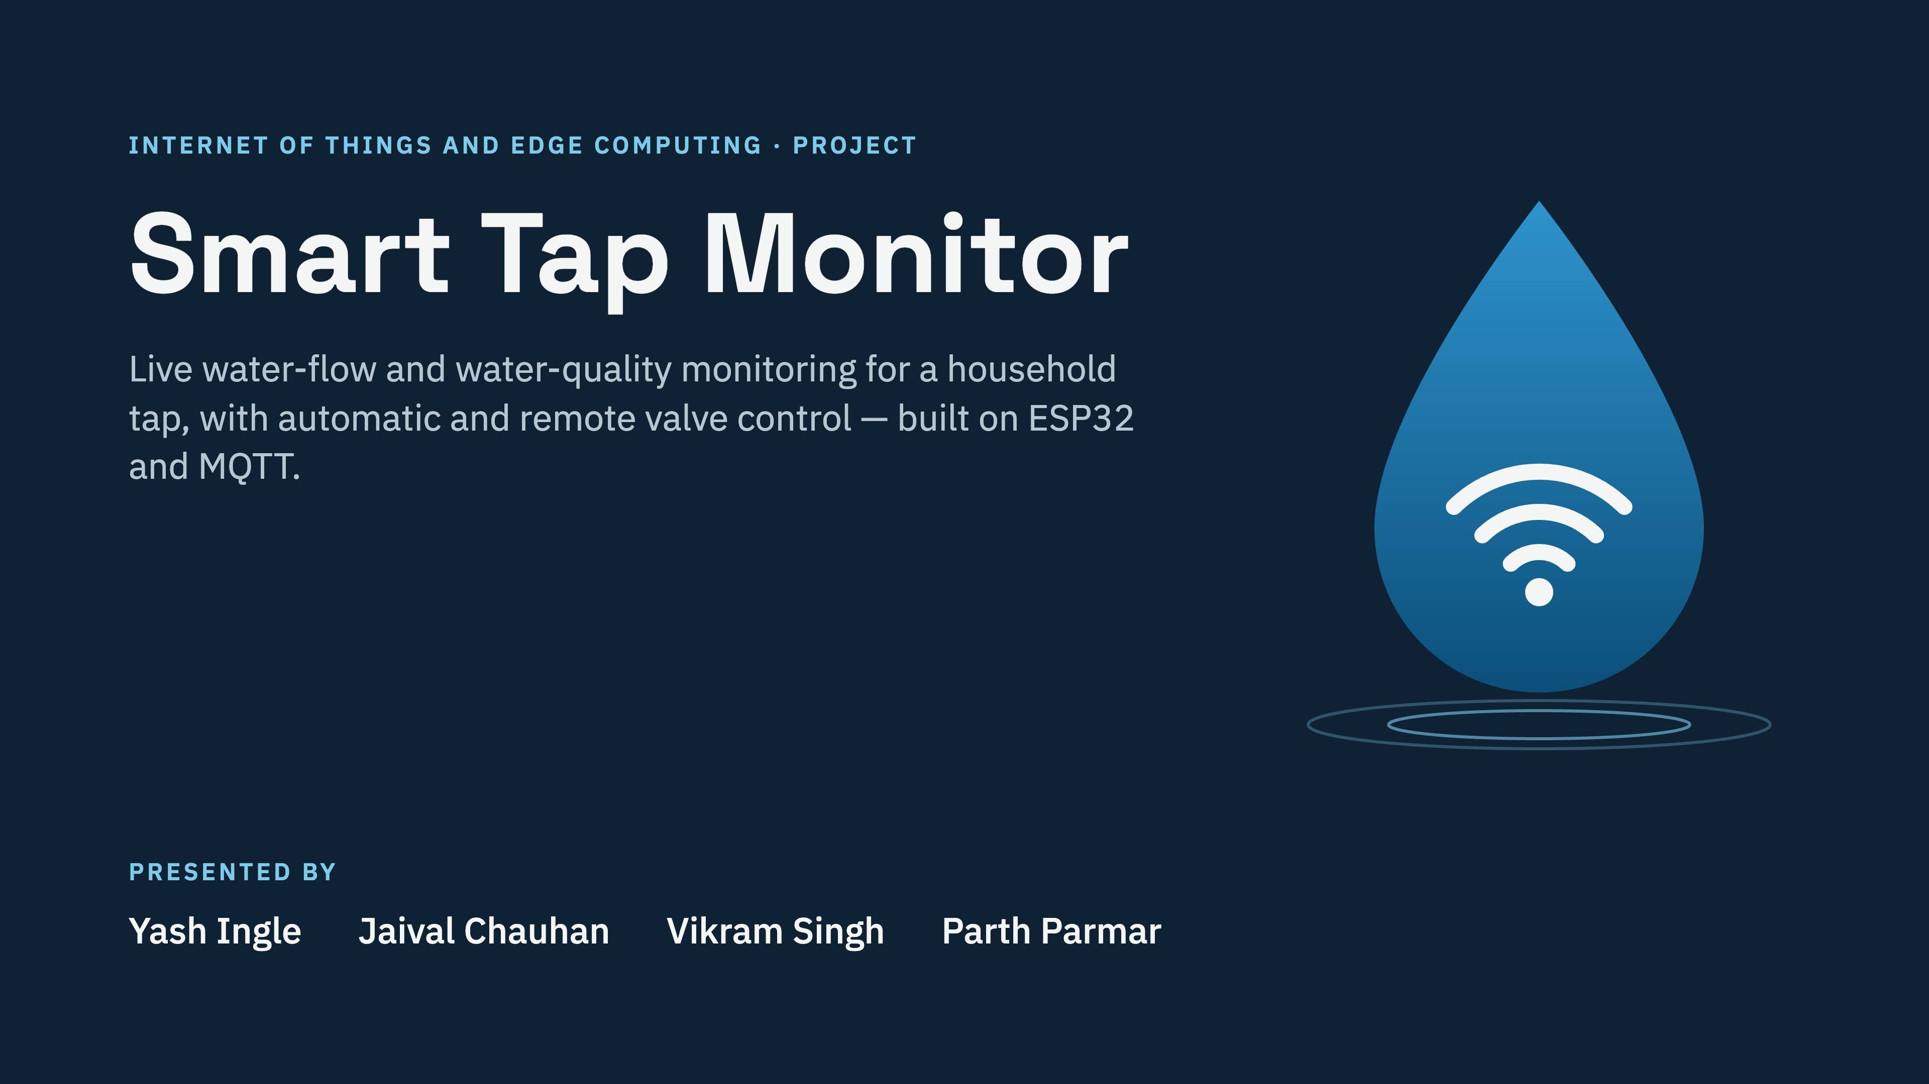
Notes:
Good morning. We are Yash, Jaival, Vikram and Parth. Our project for Internet of Things and Edge Computing is the Smart Tap Monitor: an ESP32 device that watches a household tap, tells you live whether water is flowing and whether it is safe, and can shut the valve on its own or from your phone over MQTT.

Slide 2
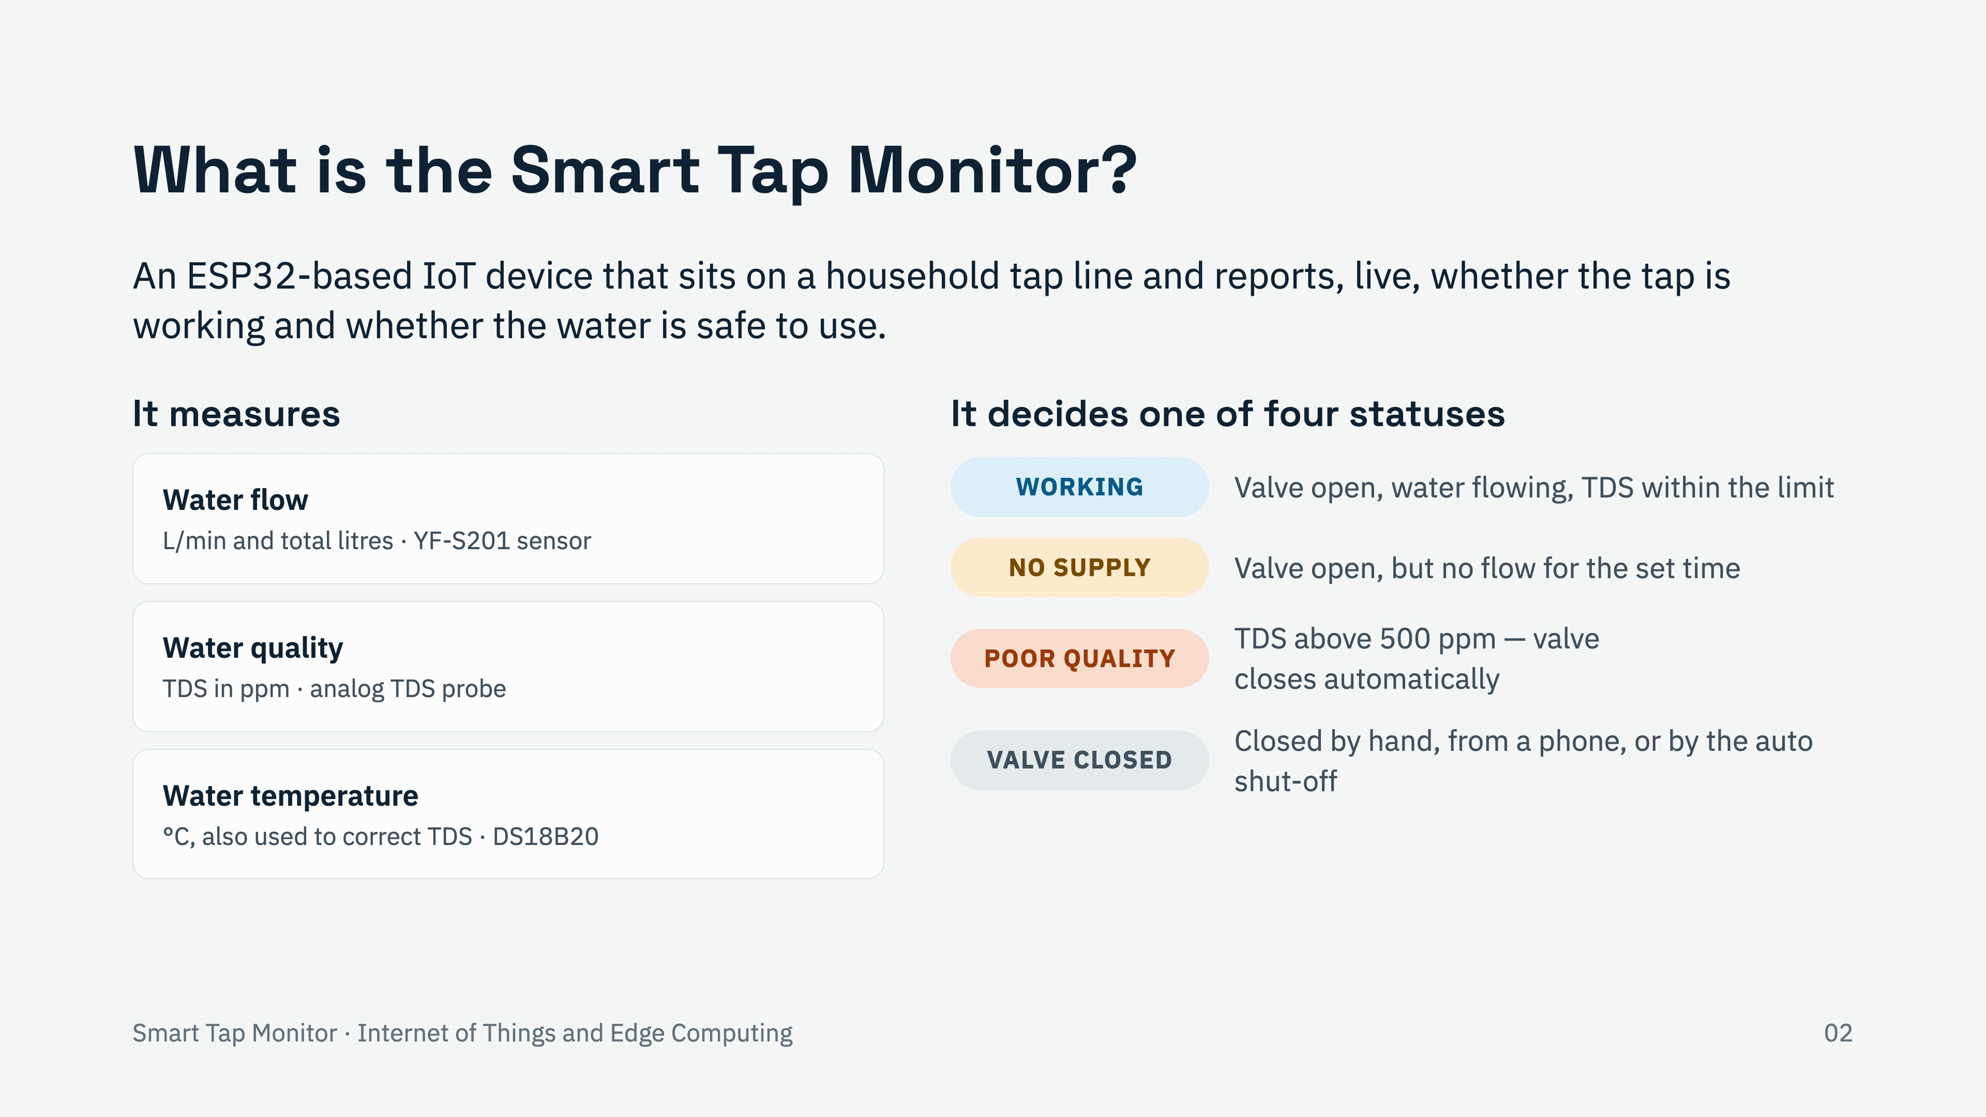
Notes:
Definition: the Smart Tap Monitor is an IoT node fixed on a tap line. It measures three things: flow (litres per minute and total litres), water quality as TDS in ppm, and temperature, which we also use to correct the TDS reading. From these it picks one of four statuses. WORKING means water is flowing and TDS is fine. NO SUPPLY means the valve is open but nothing has flowed for the set time (10 seconds in the demo). POOR QUALITY means TDS is above 500 ppm, and the valve closes itself. VALVE CLOSED means someone closed it, locally or remotely, or the auto shut-off did.

Slide 3
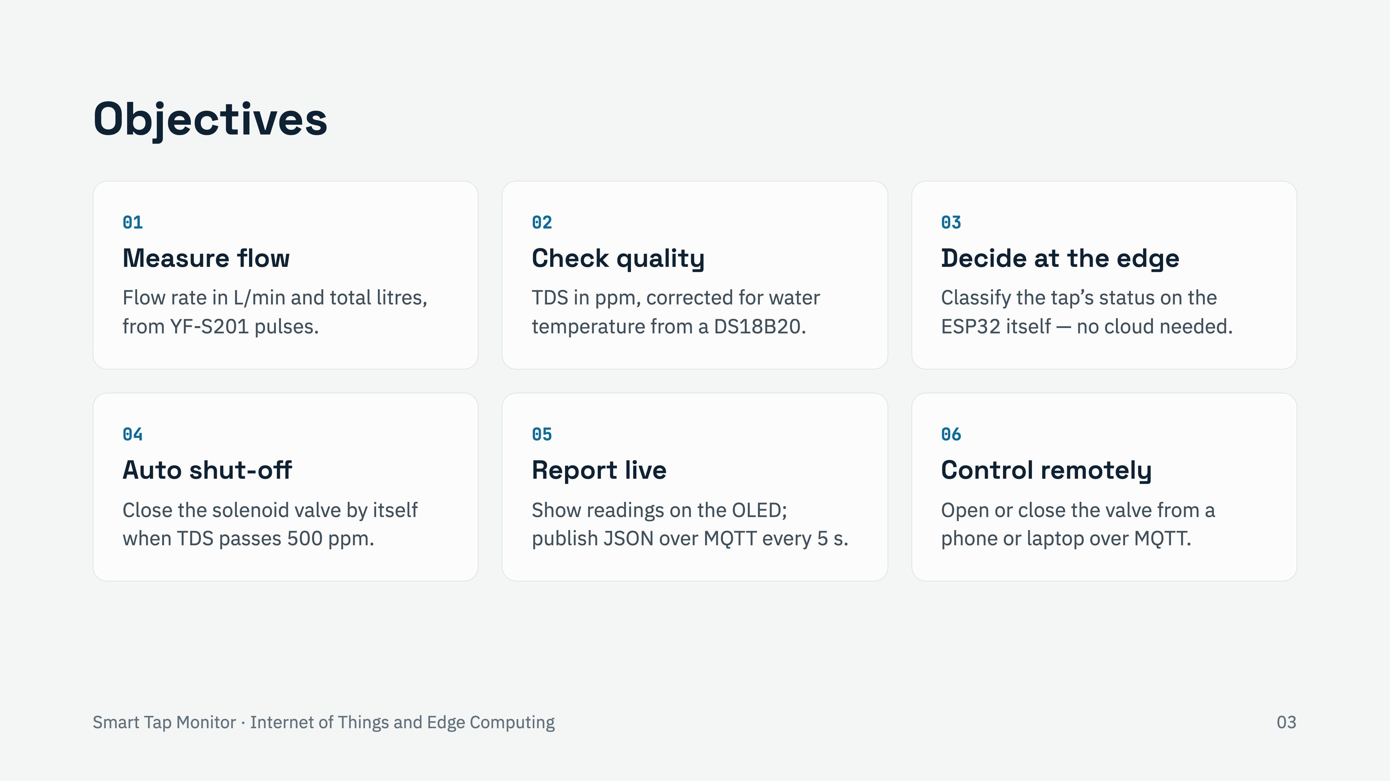
Notes:
We had six objectives. Measure flow and total consumption. Check water quality through TDS, corrected for temperature. Make the decision on the ESP32 itself, which is the edge-computing part. Shut the valve automatically when TDS crosses 500 ppm. Report everything locally on the OLED and to the internet over MQTT every five seconds. And let a user open or close the valve remotely from a phone or laptop.

Slide 4
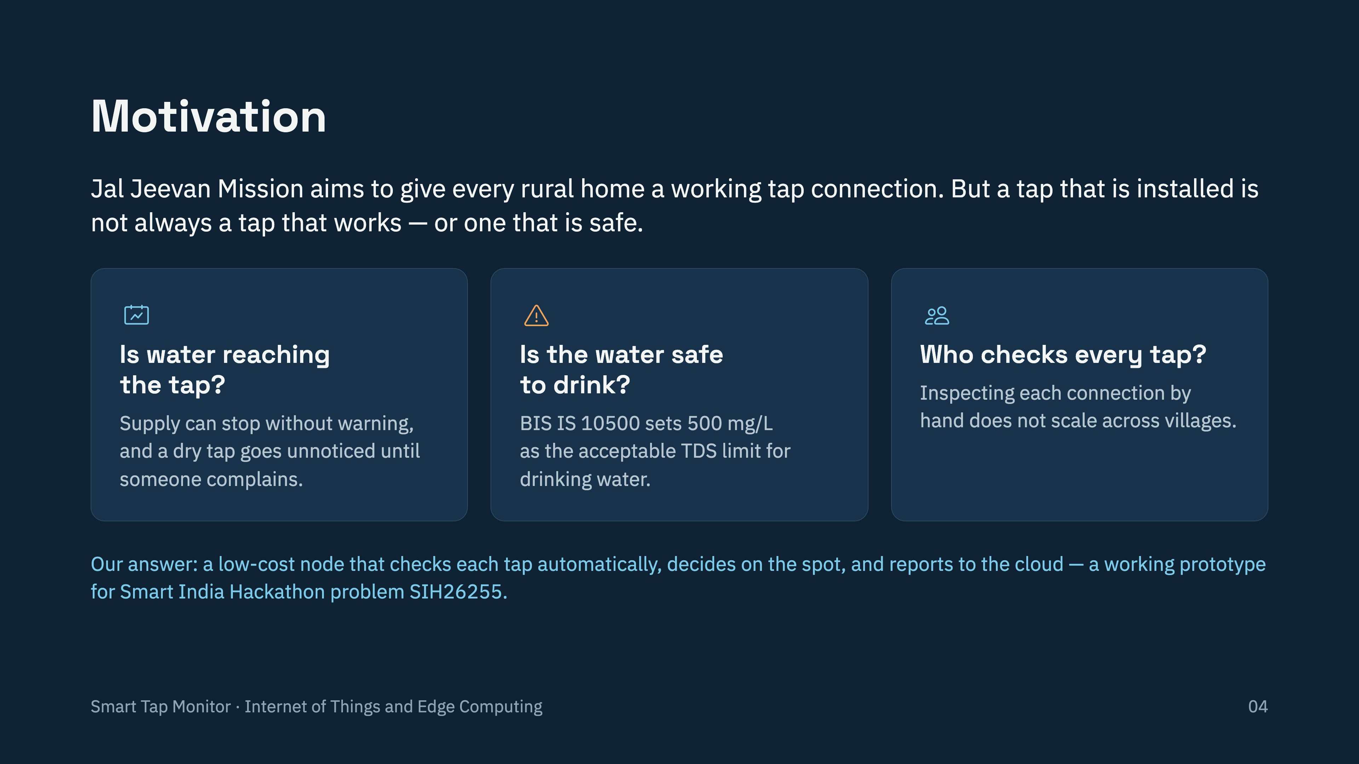
Notes:
Why this project? Under Jal Jeevan Mission (Har Ghar Jal) the goal is a functional tap connection in every rural household. Installing a tap is not the same as it working. Three questions come up. Is water actually reaching the tap? Today a dry tap is only noticed when someone complains. Is it safe? The Indian standard BIS IS 10500 puts the acceptable TDS limit at 500 mg/L, which is the threshold we use. And who checks? Manual inspection does not scale. Smart India Hackathon problem SIH26255 asks for monitoring of tap connections; our project is a working single-tap prototype of that idea.

Slide 5
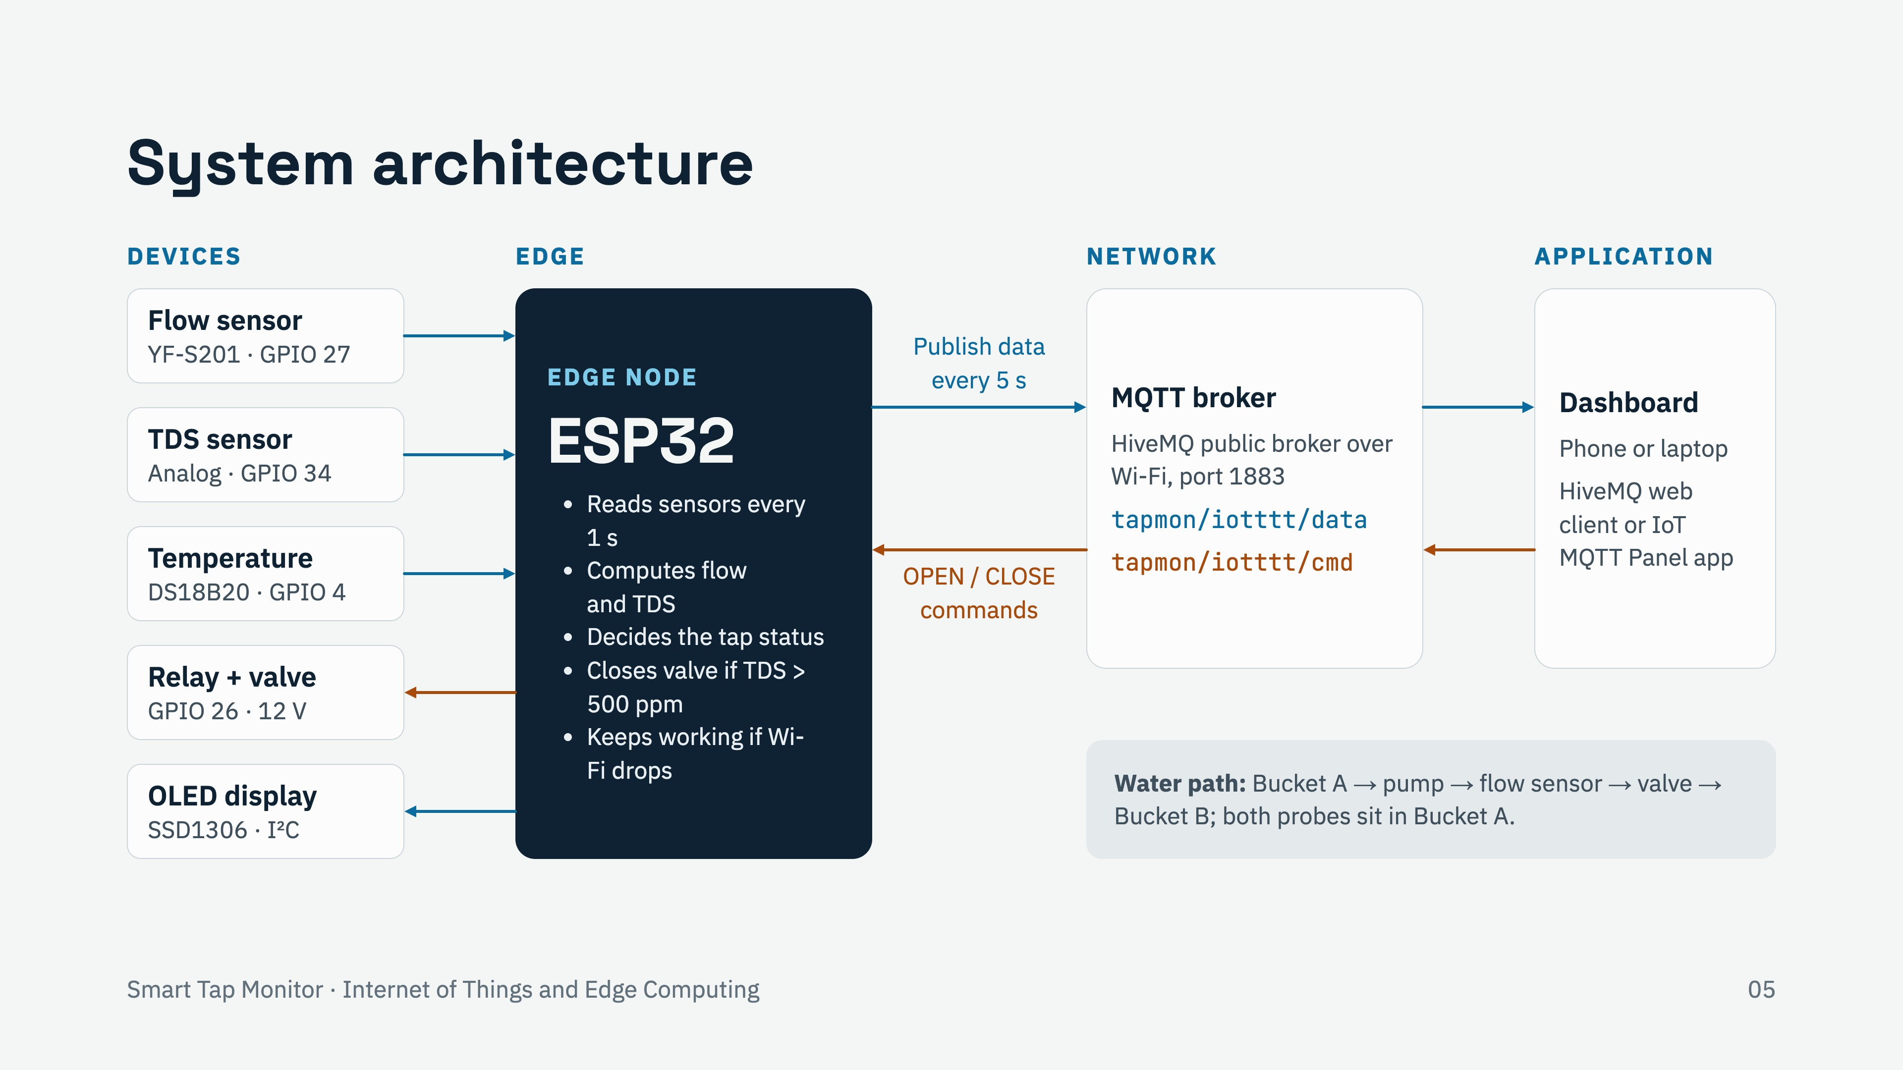
Notes:
The system follows the usual IoT layers. Devices on the left: the YF-S201 flow sensor on GPIO 27 (through a 10k/20k divider, because its signal is 5 V), the TDS sensor on analog pin 34, the DS18B20 on GPIO 4 with a 4.7k pull-up, the relay on GPIO 26 switching the 12 V solenoid valve, and the OLED on I2C pins 21 and 22. The ESP32 is the edge node: it reads everything every second and makes the decision locally. Over Wi-Fi it publishes a JSON message every 5 seconds to the HiveMQ broker on the data topic, and it subscribes to the cmd topic for OPEN and CLOSE. A phone or laptop dashboard subscribes to the data and sends the commands. Blue arrows are data, orange arrows are control. For the demo the water runs from bucket A through the pump, flow sensor and valve into bucket B.

Slide 6
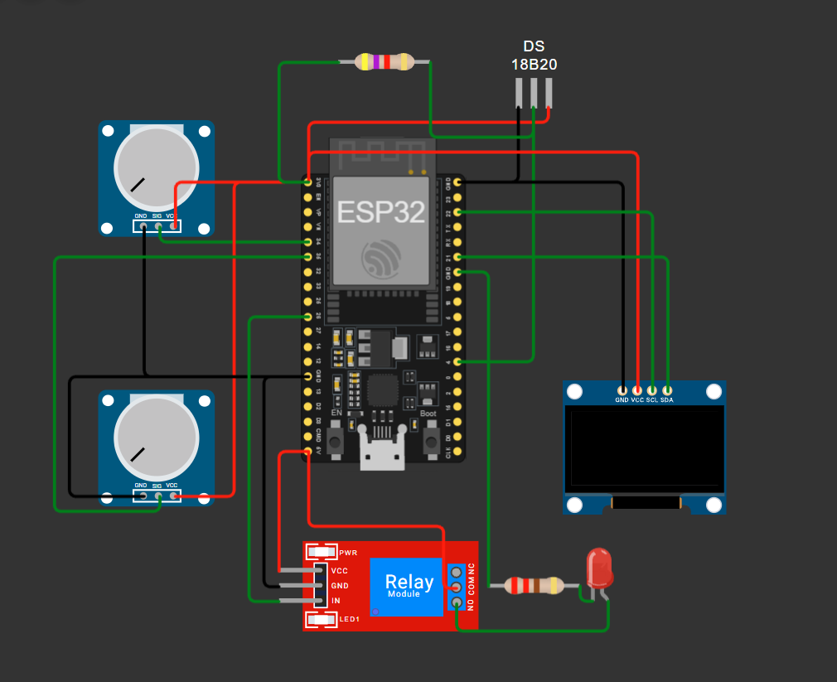
4.7K Ohm
Temperature Sensor
TDS
Flow Sensor
OLED Display
220 Ohm
Relay + Solenoid Valve

Slide 7
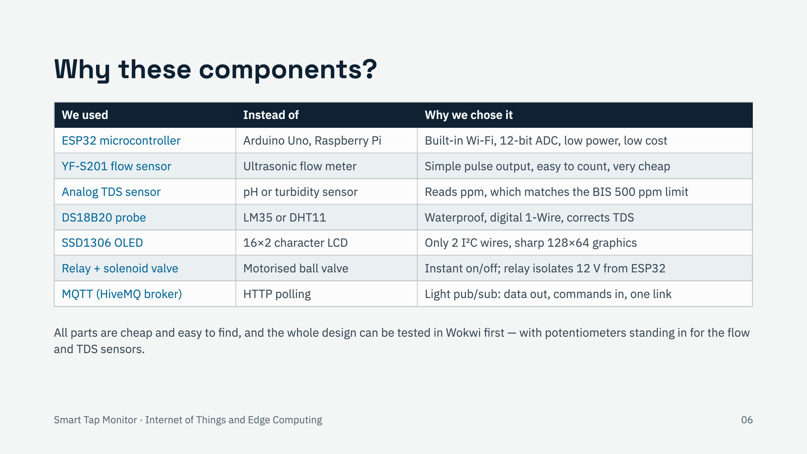
Notes:
Each part was chosen against an alternative. ESP32 over Arduino Uno because the Uno has no Wi-Fi and only a 10-bit ADC, and over a Raspberry Pi because the Pi costs more, draws more power and has no analog input. YF-S201 over an ultrasonic meter because its hall-effect pulses (about 450 per litre) are trivial to count with an interrupt and it costs a fraction. TDS over pH or turbidity because TDS maps directly to the 500 ppm limit in BIS IS 10500. DS18B20 over LM35 or DHT11 because it is a waterproof digital probe; DHT11 measures air, not water. OLED over a 16x2 LCD because it needs only two I2C wires. Relay and solenoid valve over a motorised ball valve because it switches instantly, and the relay keeps the 12 V side isolated from the ESP32. MQTT over HTTP because it is lightweight publish/subscribe, and the same connection carries data out and commands in, with no polling.

Slide 8
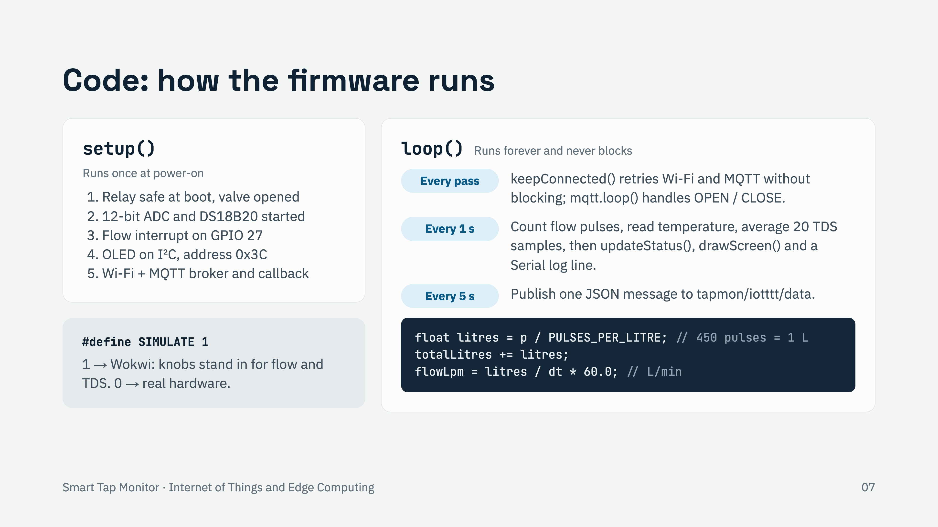
Notes:
The sketch has the usual Arduino shape. setup() runs once: it drives the relay pin to its safe level before making it an output, so the valve does not chatter at boot, then opens the valve; sets the ADC to 12 bits; starts the DS18B20; attaches an interrupt on GPIO 27 that counts falling edges from the flow sensor; starts the OLED at I2C address 0x3C; and starts Wi-Fi and the MQTT client. loop() never blocks. On every pass keepConnected() retries Wi-Fi every 10 seconds and MQTT every 5 seconds, and mqtt.loop() delivers any OPEN or CLOSE command. Once a second we read and reset the pulse counter, convert pulses to litres (about 450 pulses per litre) and to litres per minute, read temperature and TDS, update the status, redraw the OLED and print a log line. Every 5 seconds we publish the JSON. The SIMULATE flag lets the same sketch run in Wokwi, where potentiometers replace the flow and TDS sensors.

Slide 9
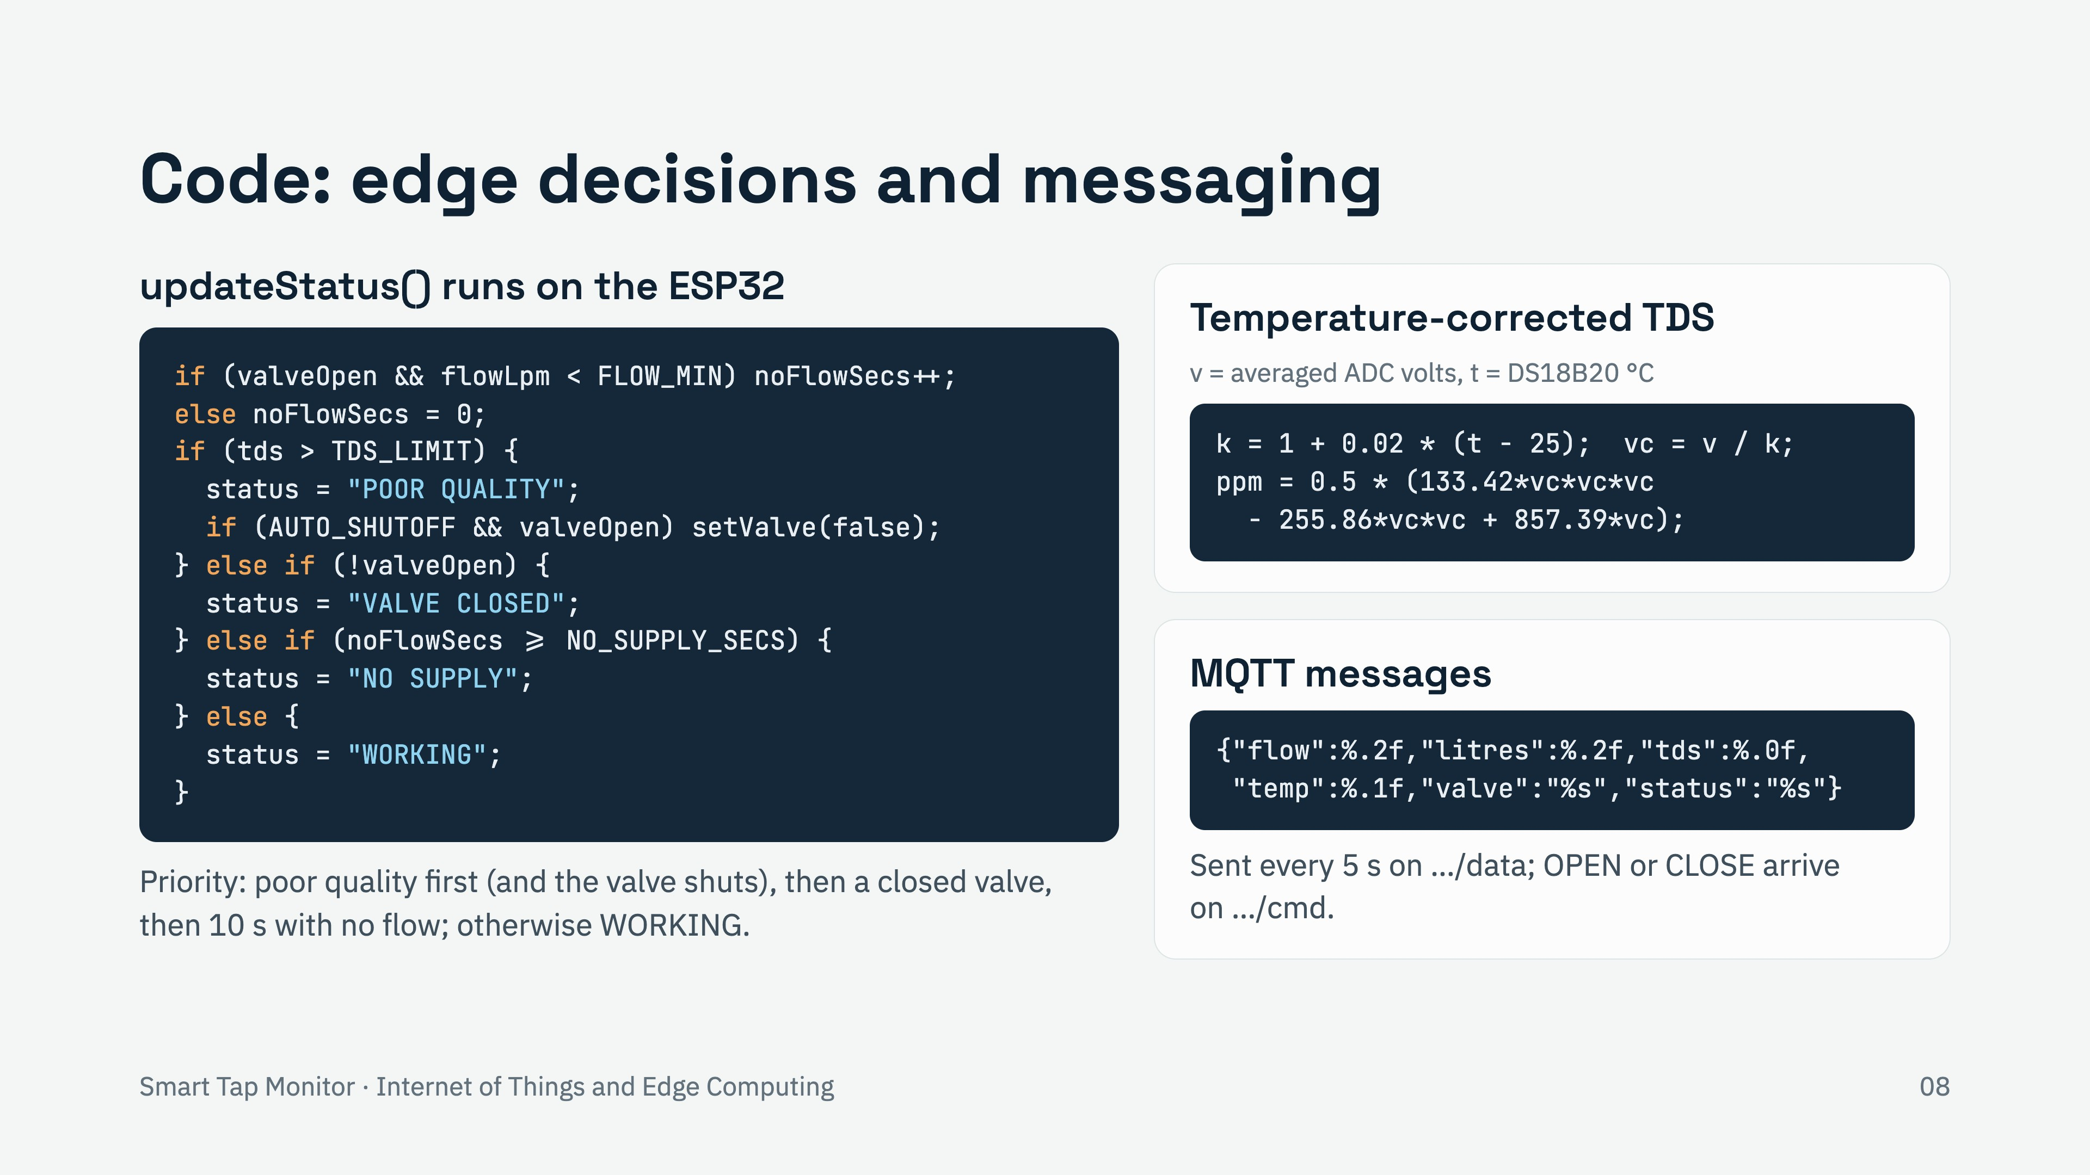
Notes:
This is the edge-computing core. updateStatus() runs every second on the ESP32 itself. First it counts how many seconds the valve has been open with flow below 0.2 L/min. Then it checks in priority order: if TDS is over 500 ppm, the status is POOR QUALITY and, because AUTO_SHUTOFF is on, it closes the valve immediately without waiting for the cloud. Otherwise, if the valve is closed, VALVE CLOSED. Otherwise, if there has been no flow for 10 seconds (600 in real use), NO SUPPLY. Otherwise WORKING. For TDS we average 20 ADC samples into a voltage, correct it to 25 °C with a 2 percent per degree factor using the DS18B20 temperature, and convert with the sensor’s cubic formula; TDS_CAL lets us calibrate against a TDS pen. Every 5 seconds the status and readings go out as one JSON message on the data topic. Commands arrive on the cmd topic; the callback trims and upper-cases the text, so open or OPEN both work.

Slide 10
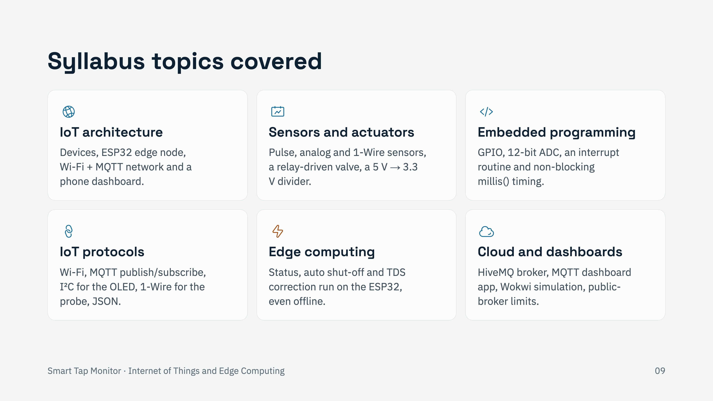
Notes:
The project touches most of the Internet of Things and Edge Computing syllabus. IoT architecture: a clear device, edge, network and application layering. Sensors and actuators: three kinds of sensor interface (pulse with interrupts, analog through the ADC, digital 1-Wire), a relay and solenoid valve as the actuator, and signal conditioning with a voltage divider to bring the 5 V flow signal down to 3.3 V. Embedded programming on the ESP32: GPIO, ADC, an interrupt service routine and millis()-based timing so nothing blocks. Protocols: Wi-Fi, MQTT publish/subscribe, I2C and 1-Wire, with JSON payloads. Edge computing: decisions and the safety shut-off happen on the device, so it keeps protecting the user even if the internet drops. Cloud and dashboards: the HiveMQ broker, a phone dashboard and the Wokwi simulator, plus the security limits of a public broker, where anyone who guesses the topic can read or send messages.

Slide 11
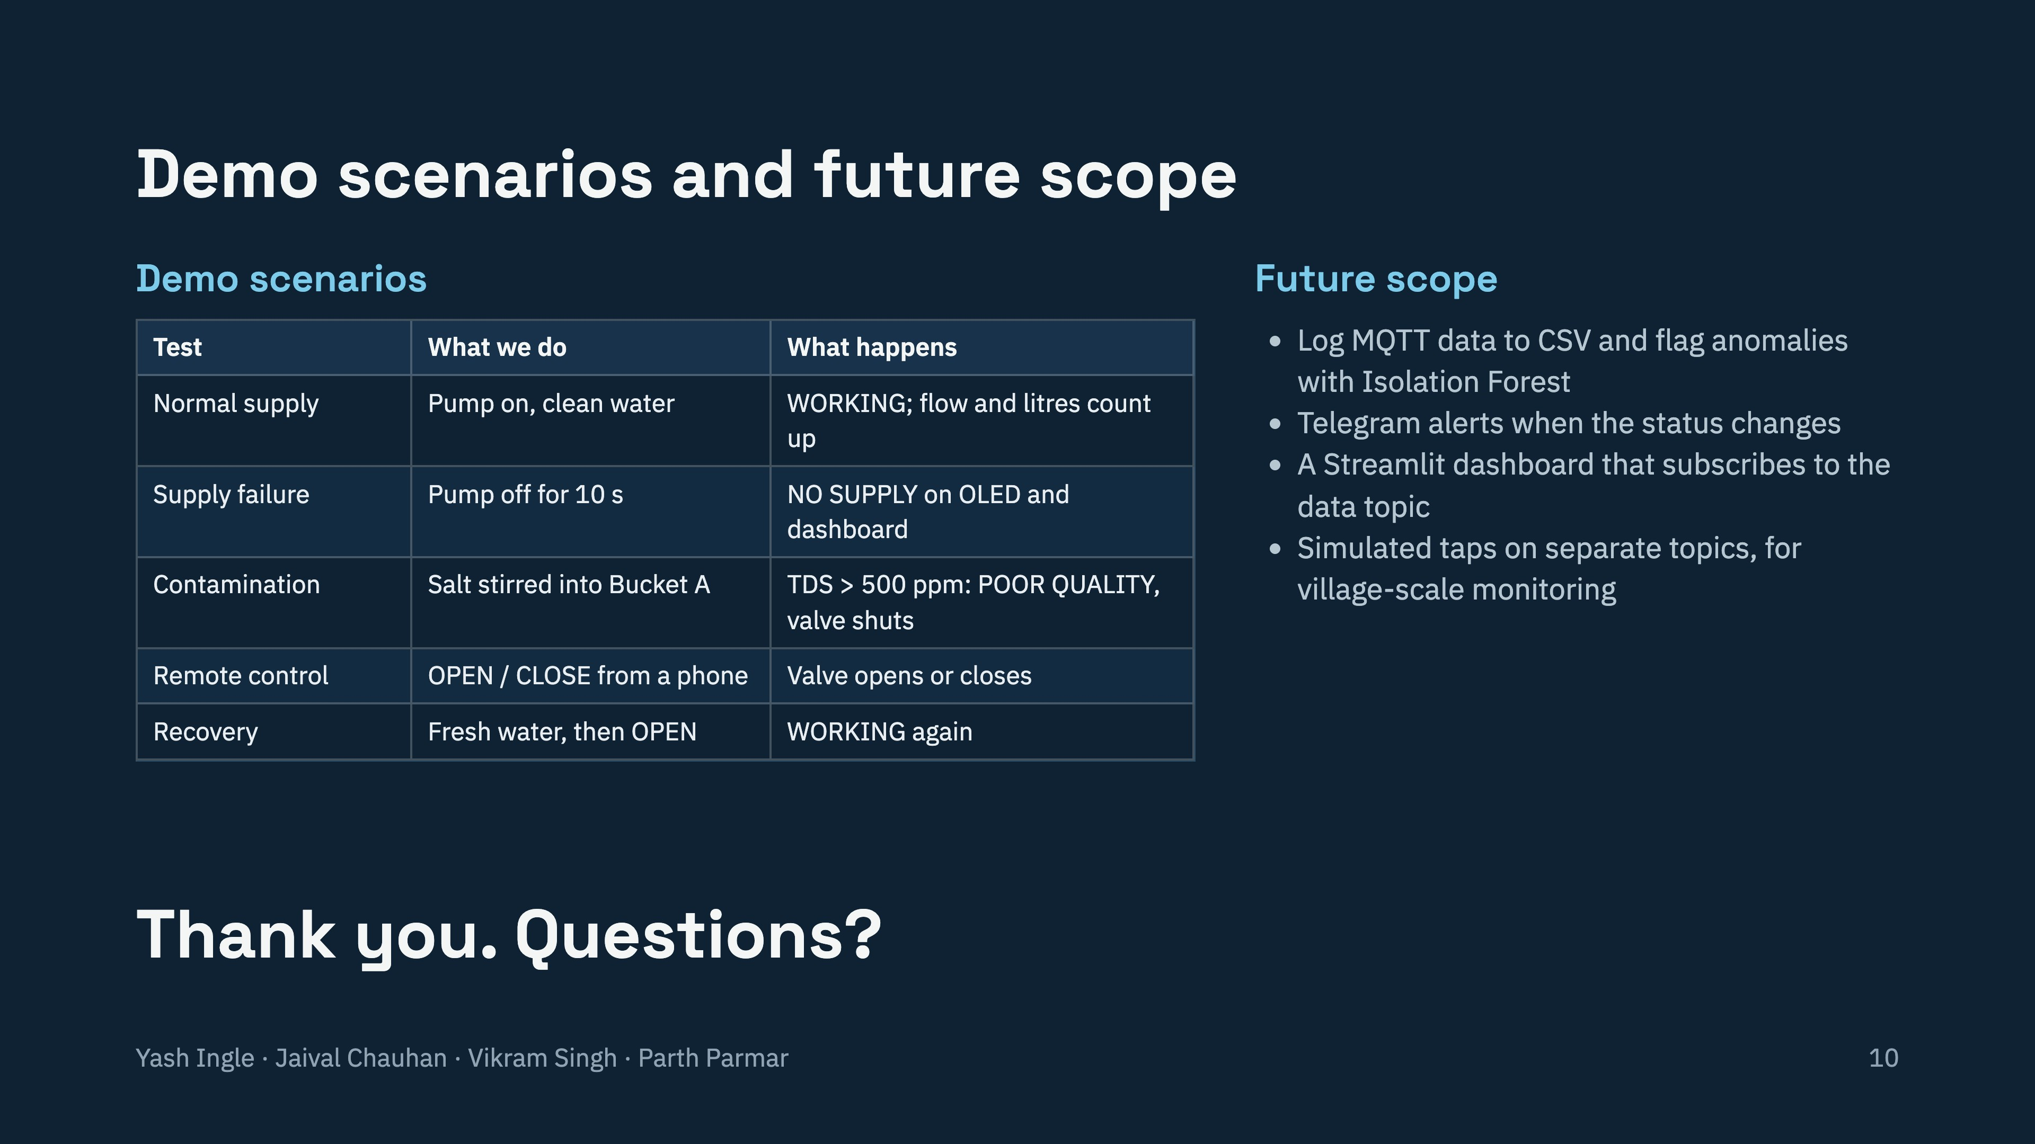
Notes:
We test five scenarios live. Normal supply: pump on with clean water, status WORKING and the litres count up. Supply failure: switch the pump off for 10 seconds and the status becomes NO SUPPLY on the OLED and the dashboard. Contamination: stir a teaspoon of salt into bucket A; TDS passes 500 ppm, the status becomes POOR QUALITY and the valve clicks shut on its own (switch the pump off by hand). Remote control: publish OPEN or CLOSE from a phone and the valve follows. Recovery: replace the water, publish OPEN, and it returns to WORKING. Next steps would be logging the MQTT data and running an Isolation Forest anomaly detector, Telegram alerts on status changes, a Streamlit dashboard, and simulating many taps on separate topics to show village-level scaling, which is what SIH26255 ultimately asks for. Thank you; we are happy to take questions.

